Slide 1




Slide 2
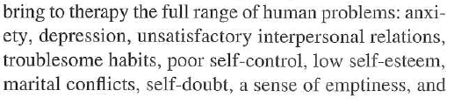





Slide 3


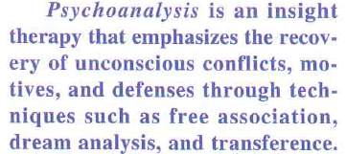

Slide 4
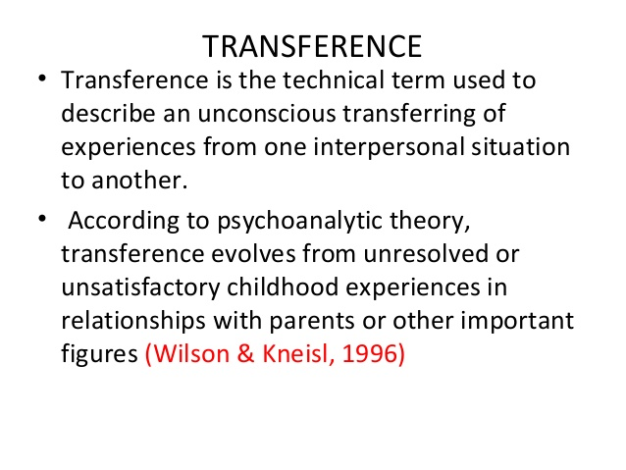

Slide 5


Slide 6





Slide 7





Slide 8





Slide 9

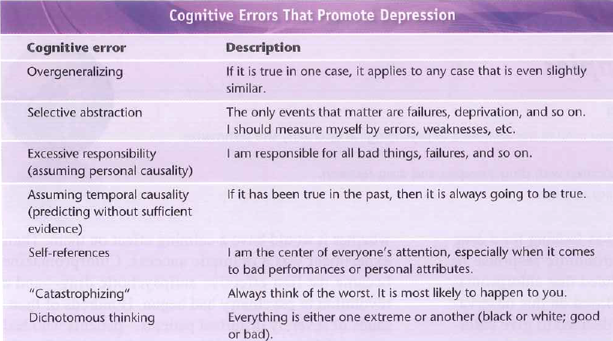

Slide 10

dichotomy example

Slide 11







